Slide 1
Adapting models
Accounting for added complexity or real time incoming knowledge
Ricardo Aguas

Slide 2
SARS-CoV-2
Severe acute respiratory syndrome
Short infection
Acute symptoms
Affects the respiratory system

Slide 3
SARS-CoV-2 early findings
High IFR ~1%
Mortality extremely age dependent
High contribution of asymptomatic infections
Lockdowns are necessary to prevent infection spread
Need vaccines to reach herd immunity

Slide 4
SARS-CoV-2 current knowledge
IFR ~0.4%
Mortality extremely age dependent
Asymptomatic infections are important; pre-symptomatic infections even more so
Role of NPIs is unclear, but it seems border control is critical
Virus evolves relatively quickly
Reaching endemic levels

Slide 5
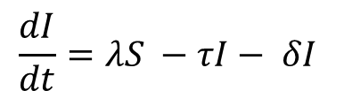
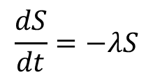
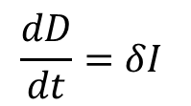
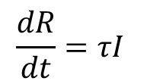
Disease induced mortality
S
λ
I
τ
R
Competing rates
$$\frac{dS}{dt}=−λS$$
δ
D
$$\frac{dI}{dt}=λS −τI− δI$$
$$\frac{dR}{dt}=τI$$
$$\frac{dD}{dt}=δI$$

Slide 6
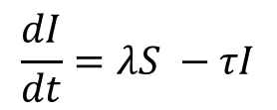
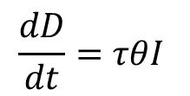
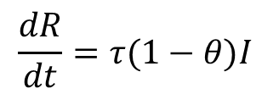
Disease induced mortality (alternate)
Rate per unit time x probability
S
λ
I
τ (1−θ)
R
Mutually exclusive outcomes
$$\frac{dS}{dt}=−λS$$
τ θ
D
$$\frac{dI}{dt}=λS −τI$$
$$\frac{dR}{dt}=τ(1−θ)I$$
$$\frac{dD}{dt}=τθI$$

Slide 7
Competing death and recovery rates
SIR_dim.R
SIR_model<-function(t, state, parameters) {
with(as.list(c(state, parameters)),{
P <- (S+I+R)
lam<-parameters['beta']*I/P
dS <- mu*P-mu*S-lam*S
dI <- lam*S-tau*I-delta*I-mu*I
dR <- tau*I-mu*R
dD <- delta*I
list(c(dS, dI, dR, dD))})
}
parameters <- c(
mu=(1/(50*52*7)),
beta=0.25,
tau=1/10,
delta = 0.25*1/10
)
Notice the 3 exit rates out of I

Slide 8
Mutually exclusive death and recovery rates
SIR_dim.R
SIR_model2<-function(t, state, parameters) {
with(as.list(c(state, parameters)),{
P <- (S+I+R)
lam<-parameters['beta']*I/P
dS <- mu*P-mu*S-lam*S
dI <- lam*S-(1-phi)*tau*I-delta*phi*I-mu*I
dR <- (1-phi)*tau*I-mu*R
dD <- delta*phi*I
list(c(dS, dI, dR, dD))})
}
parameters2 <- c(
mu = (1/(50*52*7)),
beta = 0.25,
tau = 1/10,
delta = 1/10,
phi=0.25
)
Split between delta and tau defined by phi

Slide 9
Compared the results and figure out which version gives you the desired disease fatality rate?
SIR_dim.R
plot(Result$time,Result$D, ylim = c(0,400))
lines(Result2$time,Result2$D,col="red")
tail(Result$D)/(tail(Result$D)+tail(Result$R))
tail(Result2$D)/(tail(Result2$D)+tail(Result2$R))
Look at how many people died. Is this prevalence of dead people?
Out of everyone who has left the I compartment, how many died

Slide 10
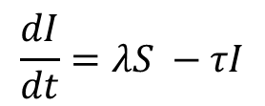
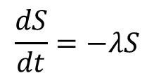
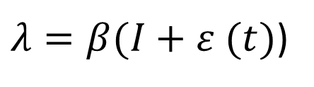
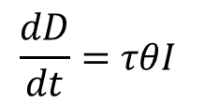
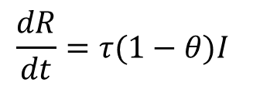
Imported infections to seed transmission
S
λ
I
τ (1−θ)
R
$λ=β(I+ε (t)$)
$$\frac{dS}{dt}=−λS$$
τ θ
D
$$\frac{dI}{dt}=λS −τI$$
$$\frac{dR}{dt}=τ(1−θ)I$$
$$\frac{dD}{dt}=τθI$$

Slide 11
SIR_dim.R
Imported infections to seed transmission
What is the model output when there are 10 importations per timestep
SIR_model2_import<-function(t, state, parameters) {
with(as.list(c(state, parameters)),{
P <- (S+I+R)
lam<-parameters['beta']*(I+imp)/P
dS <- mu*P-mu*S-lam*S
dI <- lam*S-(1-phi)*tau*I-delta*phi*I-mu*I
dR <- (1-phi)*tau*I-mu*R
dD <- delta*phi*I
list(c(dS, dI, dR, dD))})
}
parameters2['imp']<-10
out2_import <- deSolve::ode(y = istate, times = tps, func = SIR_model2_import, parms = parameters2)
Result2_import<-as.data.frame(out2_import)
plot(Result2$S,Result2$I, ylim = c(0, 300))
lines (Result2_import$S,Result2_import$I, col = "magenta")
Forcing term on FOI
Keeping with mutually exclusive DIM
Compare the result against the model without importation

Slide 12
Set beta to 0.09 and determine what the importation parameter should be for an outbreak to occur
SIR_dim.R
parameters2['beta']<-0.09
import_vector<-seq(0,10,by=1)
result_import<-matrix(0,nrow = 1,ncol = 3)
colnames(result_import)<-c("time","I","imp")
result_import<-as.data.frame(result_import)
for (i in 1:length(import_vector)){
parameters2["imp"]<-import_vector[i]
out_aux <- deSolve::ode(y = istate, times = tps, func = SIR_model2_import, parms = parameters2)
aux_mat<-cbind(out_aux[,c(1,3)],rep(import_vector[i],length(tps)))
colnames(aux_mat)<-c("time","I","imp")
result_import<-rbind(result_import,aux_mat)
}
Sensitivity analysis on importation
The results object is a matrix with defined column names
Record the full time series for each value of importation in result_import

Slide 13
Visualizing the sensitivity analysis
SIR_dim.R
library(ggplot2)
g<-ggplot(result_import)
g<-g+geom_line(aes(x=time,y=I,colour=as.factor(imp)))
g
Use ggplot to see labelled curves

Slide 14
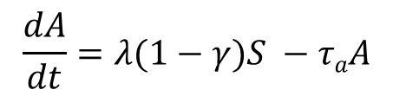
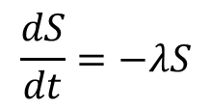
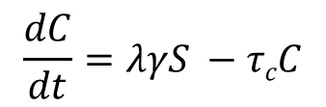
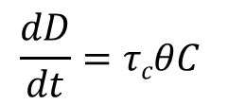
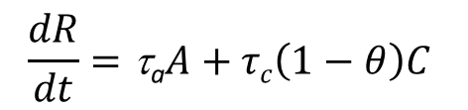
Asymptomatic infections
A
λ(1−γ)
τ_{a}
S
R
$$\frac{dS}{dt}=−λS$$
λγ
τ_{c}(1−θ)
C
$$\frac{dA}{dt}=λ(1−γ)S −τaA$$
$$\frac{dC}{dt}=λγS −τcC$$
τ_{c} θ
$$\frac{dR}{dt}=\text{t}\text{a}A+τc\left(1−θ\right)C$$
D
$$\frac{dD}{dt}=τcθC$$

Slide 15
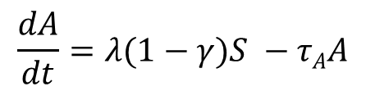
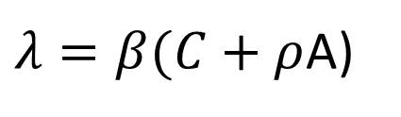
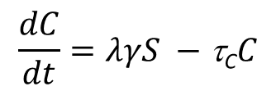
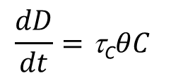
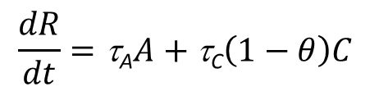
Symptoms dictate infectiousness
A
$λ=β(C+ρ$A)
λ(1−γ)
τ_{A}
S
R
$$\frac{dS}{dt}=−λS$$
λγ
τ_{C}(1−θ)
C
$$\frac{dA}{dt}=λ(1−γ)S −τAA$$
$$\frac{dC}{dt}=λγS −\text{t}\text{C}C$$
τ_{C} θ
$$\frac{dR}{dt}=\text{t}\text{A}A+\text{t}\text{C}\left(1−θ\right)C$$
D
$$\frac{dD}{dt}=\text{t}\text{C}θC$$

Slide 16
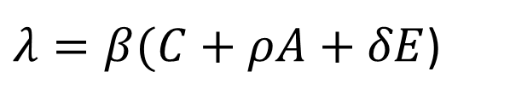
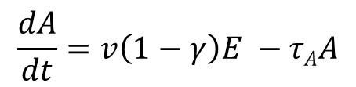
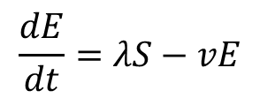
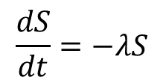
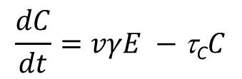
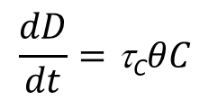
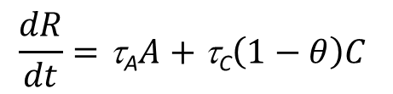
“Pre-symptomatic” infectious incubation period
$λ=β(C+ρA+δE$)
A
ν(1−γ)
τ_{A}
S
λ
E
R
νγ
τ_{C}(1−φ)
C
$$\frac{dS}{dt}=−λS$$
$$\frac{dC}{dt}=vγE −\text{t}\text{C}C$$
τ_{C} φ
$$\frac{dE}{dt}=λS−vE$$
$$\frac{dR}{dt}=\text{t}\text{A}A+\text{t}\text{C}\left(1−θ\right)C$$
D
$$\frac{dA}{dt}=v\left(1−γ\right)E −τAA$$
$$\frac{dD}{dt}=\text{t}\text{C}θC$$

Slide 17
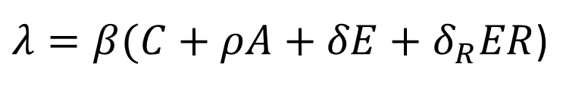
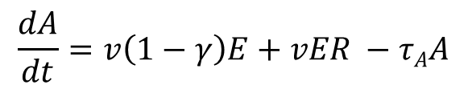
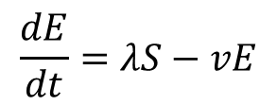
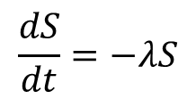
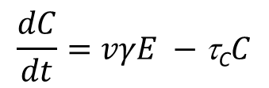
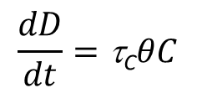

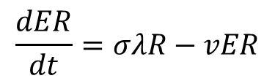
Partial/temporary clinical immunity
ER
ν
$λ=β(C+ρA+δE+δ_{R}ER$)
A
ν(1−γ)
τ_{A}
σλ
S
λ
E
R
νγ
τ_{C}(1−θ)
C
$$\frac{dS}{dt}=−λS$$
α
$$\frac{dE}{dt}=λS−vE$$
$\frac{dR}{dt}=\text{t}\text{A}A+\text{t}\text{C}\left(1−θ\right)C−σλ$R
τ_{C} θ
$$\frac{dA}{dt}=v\left(1−γ\right)E+vER −τAA$$
$$\frac{dER}{dt}=σλR−vER$$
D
$$\frac{dC}{dt}=vγE −\text{t}\text{C}C$$
$$\frac{dD}{dt}=\text{t}\text{C}θC$$

Slide 18
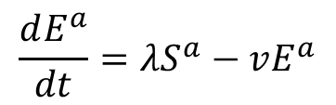
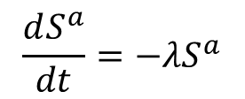
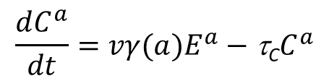
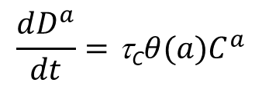
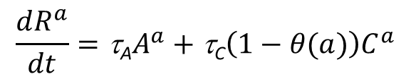

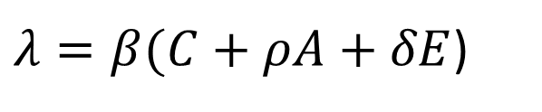
Age dependent disease and death risk
Aª
ν(1−γ(a))
τ_{A}
Sª
λ
Eª
Rª
νγ(a)
τ_{C}(1−θ(a))
Cª
$λ=β(C+ρA+δE$)
$$\frac{dS^{a}}{dt}=−λS^{a}$$
$$\frac{dC^{a}}{dt}=vγ(a)E^{a}−\text{t}\text{C}C^{a}$$
τ_{C} θ(a)
$$\frac{dE^{a}}{dt}=λS^{a}−vE^{a}$$
$$\frac{dR^{a}}{dt}=\text{t}\text{A}A^{a}+\text{t}\text{C}\left(1−θ(a)\right)C^{a}$$
Dª
$\frac{dA^{a}}{dt}=v\left(1−γ(a)\right)E^{a}−τA$ $A^{a}$
$$\frac{dD^{a}}{dt}=\text{t}\text{C}θ(a)C^{a}$$

Slide 19
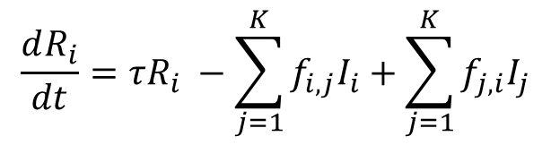
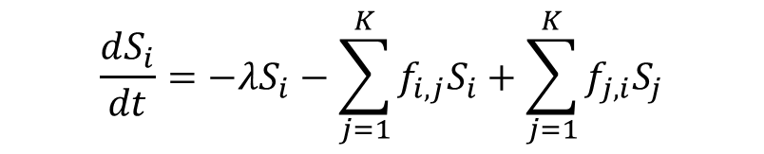
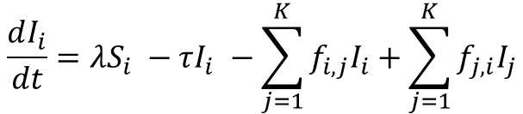
Different risks in interconnected spatial areas
f_{1,2}
S₁
λ
I₁
τ
R₁
S₂
λ
I₂
τ
R₂
f_{2,1}
$$\frac{dS_{i}}{dt}=−λS_{i}−\sum_{j=1}^{K}{f_{i,j}S_{i}+\sum_{j=1}^{K}{f_{j,i}S_{j}}}$$
$$\frac{dR_{i}}{dt}=τR_{i} −\sum_{j=1}^{K}{f_{i,j}I_{i}+\sum_{j=1}^{K}{f_{j,i}I_{j}}}$$
Population movement
$$\frac{dI_{i}}{dt}=λS_{i} −τI_{i} −\sum_{j=1}^{K}{f_{i,j}I_{i}+\sum_{j=1}^{K}{f_{j,i}I_{j}}}$$

Slide 20
Multi-strain dynamics
α₁
α₂
I₁
τ₁
R₁
σλ₂
I¹₂
τ₂
λ₁
S
R₁₂
I₂
τ₂
R₂
σλ₁
I²₁
λ₂
τ₁
α₂
α₁

Slide 21
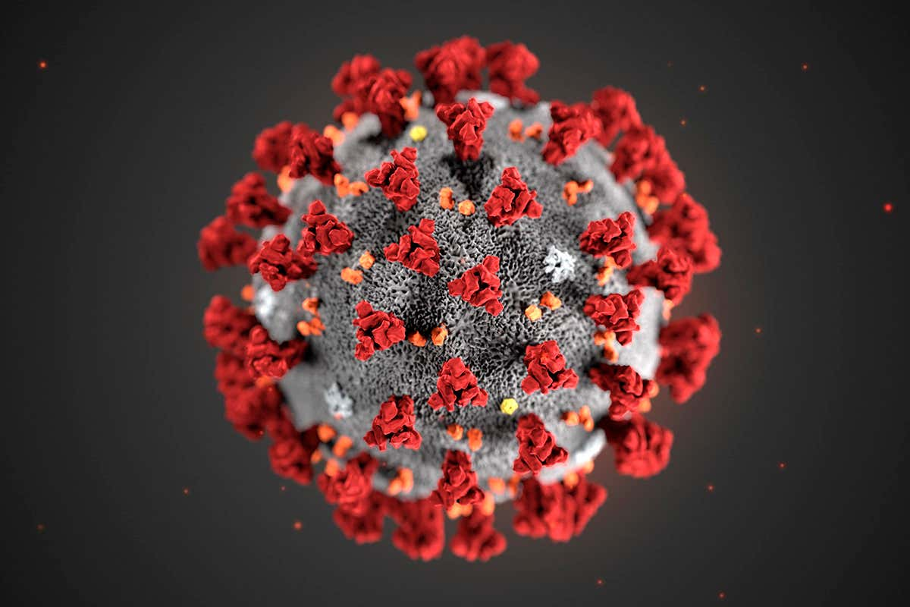
Como Model

Slide 22
Inputs
Lines 30-96
file_path <- paste0(getwd(),"/Template_CoMoCOVID-19App_v17_all_interventions.xlsx")
country_name<-"United Kingdom of Great Britain“
param <- bind_rows(read_excel(file_path, sheet = "Parameters"),
read_excel(file_path, sheet = "Country Area Param"),
read_excel(file_path, sheet = "Virus Param"),
read_excel(file_path, sheet = "Hospitalisation Param"),
read_excel(file_path, sheet = "Interventions Param"),
read_excel(file_path, sheet = "Interventions"))
Label_1 | Label_2 | Value | Unit | Type | Parameter
Self-isolation if Symptomatic
 | Adherence: | 50 | % | slider | selfis_eff
(*Self-isolation) Screening
 | Overdispersion: (1, 2, 3, 4 or 5) | 4 |  | slider | screen_overdispersion
 | Test Sensitivity: | 80 | % | slider | screen_test_sens
(*Self-isolation) Household Isolation
 | Days in isolation for average person: | 14 | days | slider | quarantine_days
 | Days to implement maximum quarantine coverage: (1 to 5) | 2 | days | slider | quarantine_effort

Slide 23
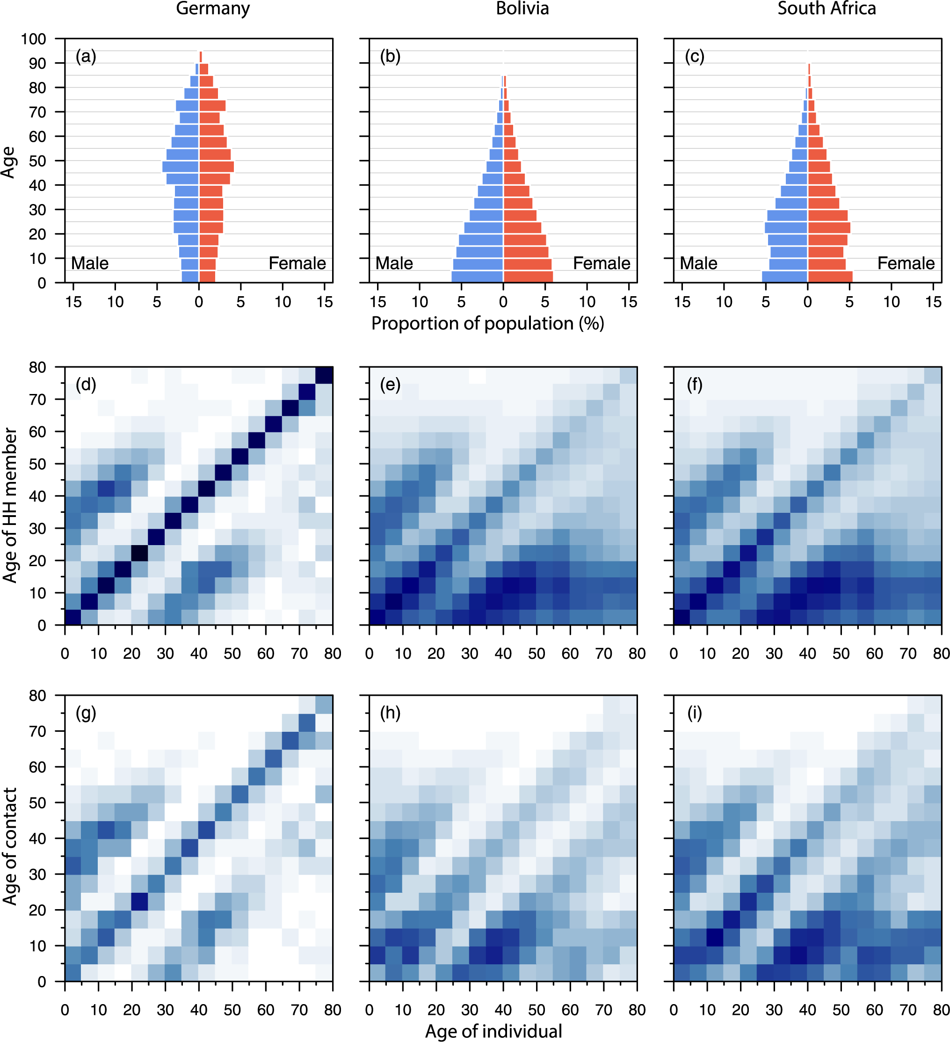
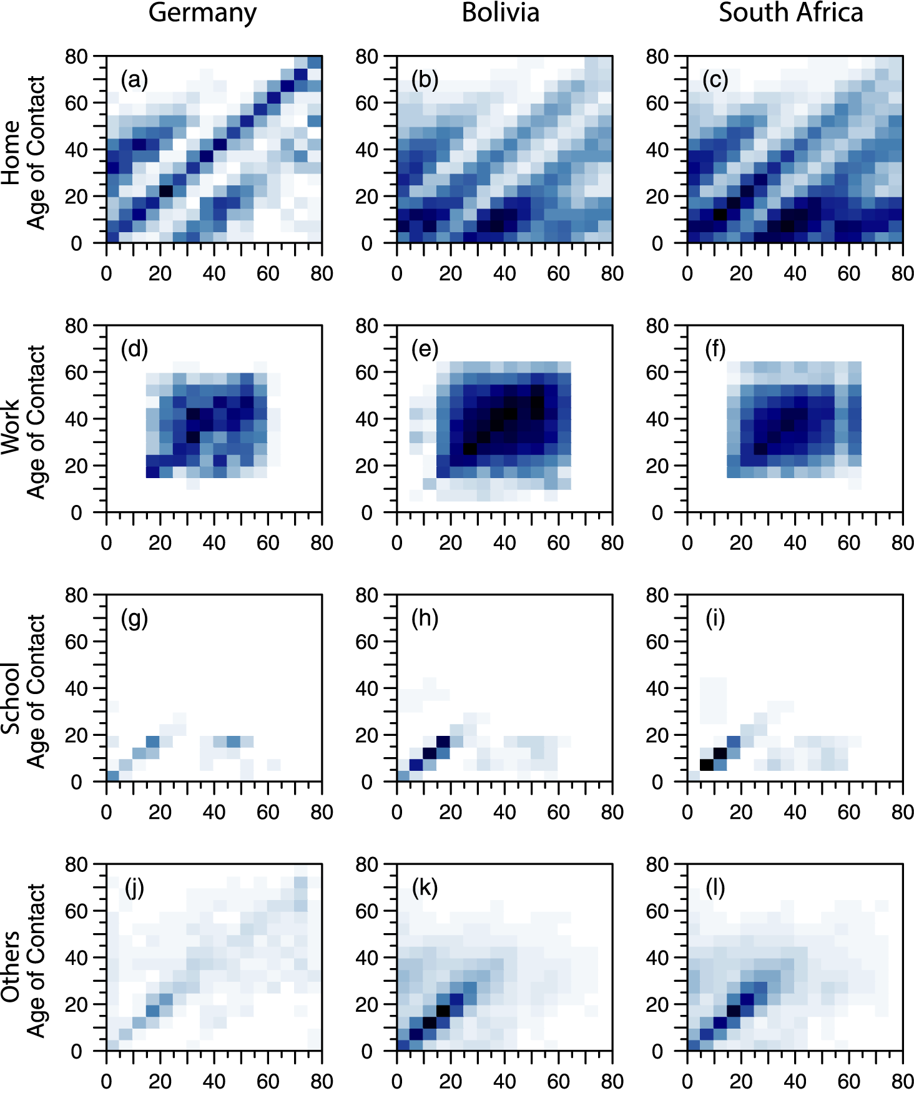
Inputs
Lines 101-145
load("data_CoMo.RData")
…

Slide 24
Model initialization
startdate <- param$Value_Date[param$Parameter == "date_range_simul_start"]
stopdate <- param$Value_Date[param$Parameter == "date_range_simul_end"]
Parameter definition
Lines 166-396
parameters <- c(
### Transmission instrinsic
p = param$Value[param$Parameter=="p"][1],
rho = param$Value[param$Parameter=="rho"][1],
omega = param$Value[param$Parameter=="omega"][1],
gamma = param$Value[param$Parameter=="gamma"][1],

Slide 25
Set-up the model system
# Define the indices for each variable
Sindex<-1:A
Eindex<-(A+1):(2*A)
Iindex<-(2*A+1):(3*A)
Rindex<-(3*A+1):(4*A)
Xindex<-(4*A+1):(5*A)
Define initial conditions
initI<-0*popstruc[,2] # Infected and symptomatic
initE<-0*popstruc[,2] # Incubating
# initE[aci]<-1 # place random index case in E compartment
initE[aci]<-parameters["init"] # place random index case in E compartment
initR<-parameters["pre"]*popstruc[,2] # Immune

Slide 26
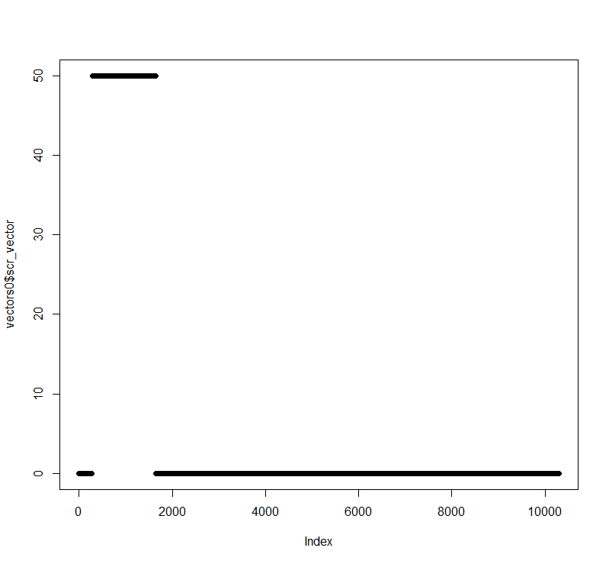
Time- varying Interventions
Lines 488-1079
inp <- read_excel(file_path, sheet = "Interventions")
inputs<-function(inp, run){
tv<-which(inp$`Apply to`==run)
si<-intersect(which(inp$Intervention=="Self-isolation if Symptomatic"),tv)
scr<-intersect(which(inp$Intervention=="(*Self-isolation) Screening"),tv)
sd<-intersect(which(inp$Intervention=="Social Distancing"),tv)

Slide 27
ODE system
Lines 1082-1553
covid<-function(t, Y, parameters,input)
{
with(as.list(c(Y, parameters)),
{
S <- Y[Sindex]
E <- Y[Eindex]
Y<-c(initS,initE,initI,initR,initX,initH,initHC,initC,initCM,initV, initQS, initQE, initQI, initQR, initCL, initQC, initICU,
initICUC, initICUCV, initVent, initVentC, initCMC,initZ, initEV, initER, initEVR, initVR,
initQV,initQEV,initQEVR,initQER,initQVR,initHCICU,initHCV,initAb)
out0 <- ode(y = Y, times = times, method = "euler", hini = 0.05, func = covid, parms = parameters, input=vectors0)

Slide 28
ODE system
A
p1
S
β
E
p2
C
R
p3
βr
H
Infection
Natural immunity loss

Slide 29
Introducing Gaussian noise
Lines 2082-2229
multi_runs<-function(Y,times,parameters,input,iterations,noise,confidence,fit,fit_mat){
results <- list()
aux<-array(0, dim=c(length(times),35*A+1,iterations))
results$mean<-matrix(0,nrow = length(times),ncol = 35*A+1)
results$min<-matrix(0,nrow = length(times),ncol = 35*A+1).
.
.
param_vector[parameters_noise]<-parameters[parameters_noise]+rnorm(length(parameters_noise),mean=0,sd=noise*abs(parameters[parameters_noise]))

Slide 30
Process outputs
Lines 1631-2078
process_ode_outcome <- function(out, iterations, intv_vector){
out_min<-out$min
out_max<-out$max
out_mean<-out$mean
.
.
}
return(results)
}

Slide 31
Hospital Sub - Model
3 main aspects to consider:
Treatment seeking
Resource availability
Patient’s clinical pathways

Slide 32

Vaccination
A
p1
S
β
E
p2
C
R
Imperfect vaccine with limited duration of efficacy
Vaccine induced immunity works independently from natural immunity
Separate efficacy for different clinical outcomes:
Infection
Symptoms
Severe disease
p3
βr
H
A
pv1
pvr1
V
βv
EV
pv2
C
pvr2
EVR
βvr
VR
pv3
pvr3
H
Infection
Natural immunity loss
Vaccination
Vaccination induced immunity loss
$$\left\{β,p1,p2,p3\right\}≠\left\{βv,pv1,pv2,pv3\right\}$$
$$\left\{β,p1,p2,p3\right\}≠\left\{βvr,pvr1,pvr2,pvr3\right\}$$

